Slide 1
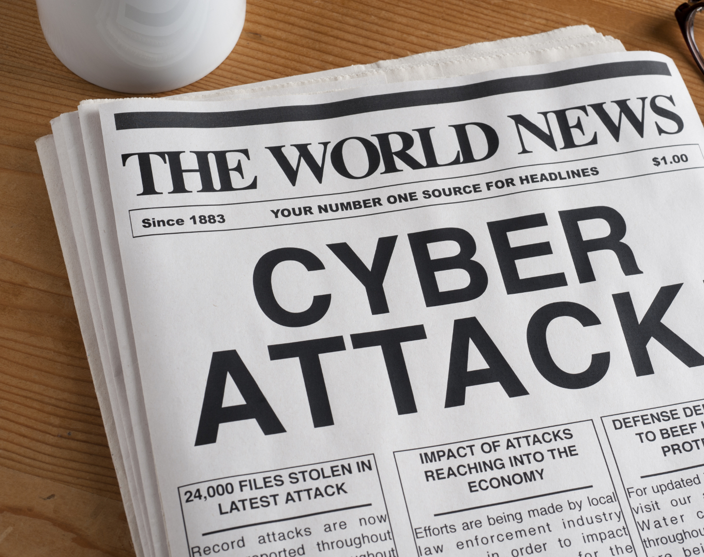
Cyber Minutes Weekly
"Hard to breach"
11-8-2023 | Jonathan Montoya

Slide 2
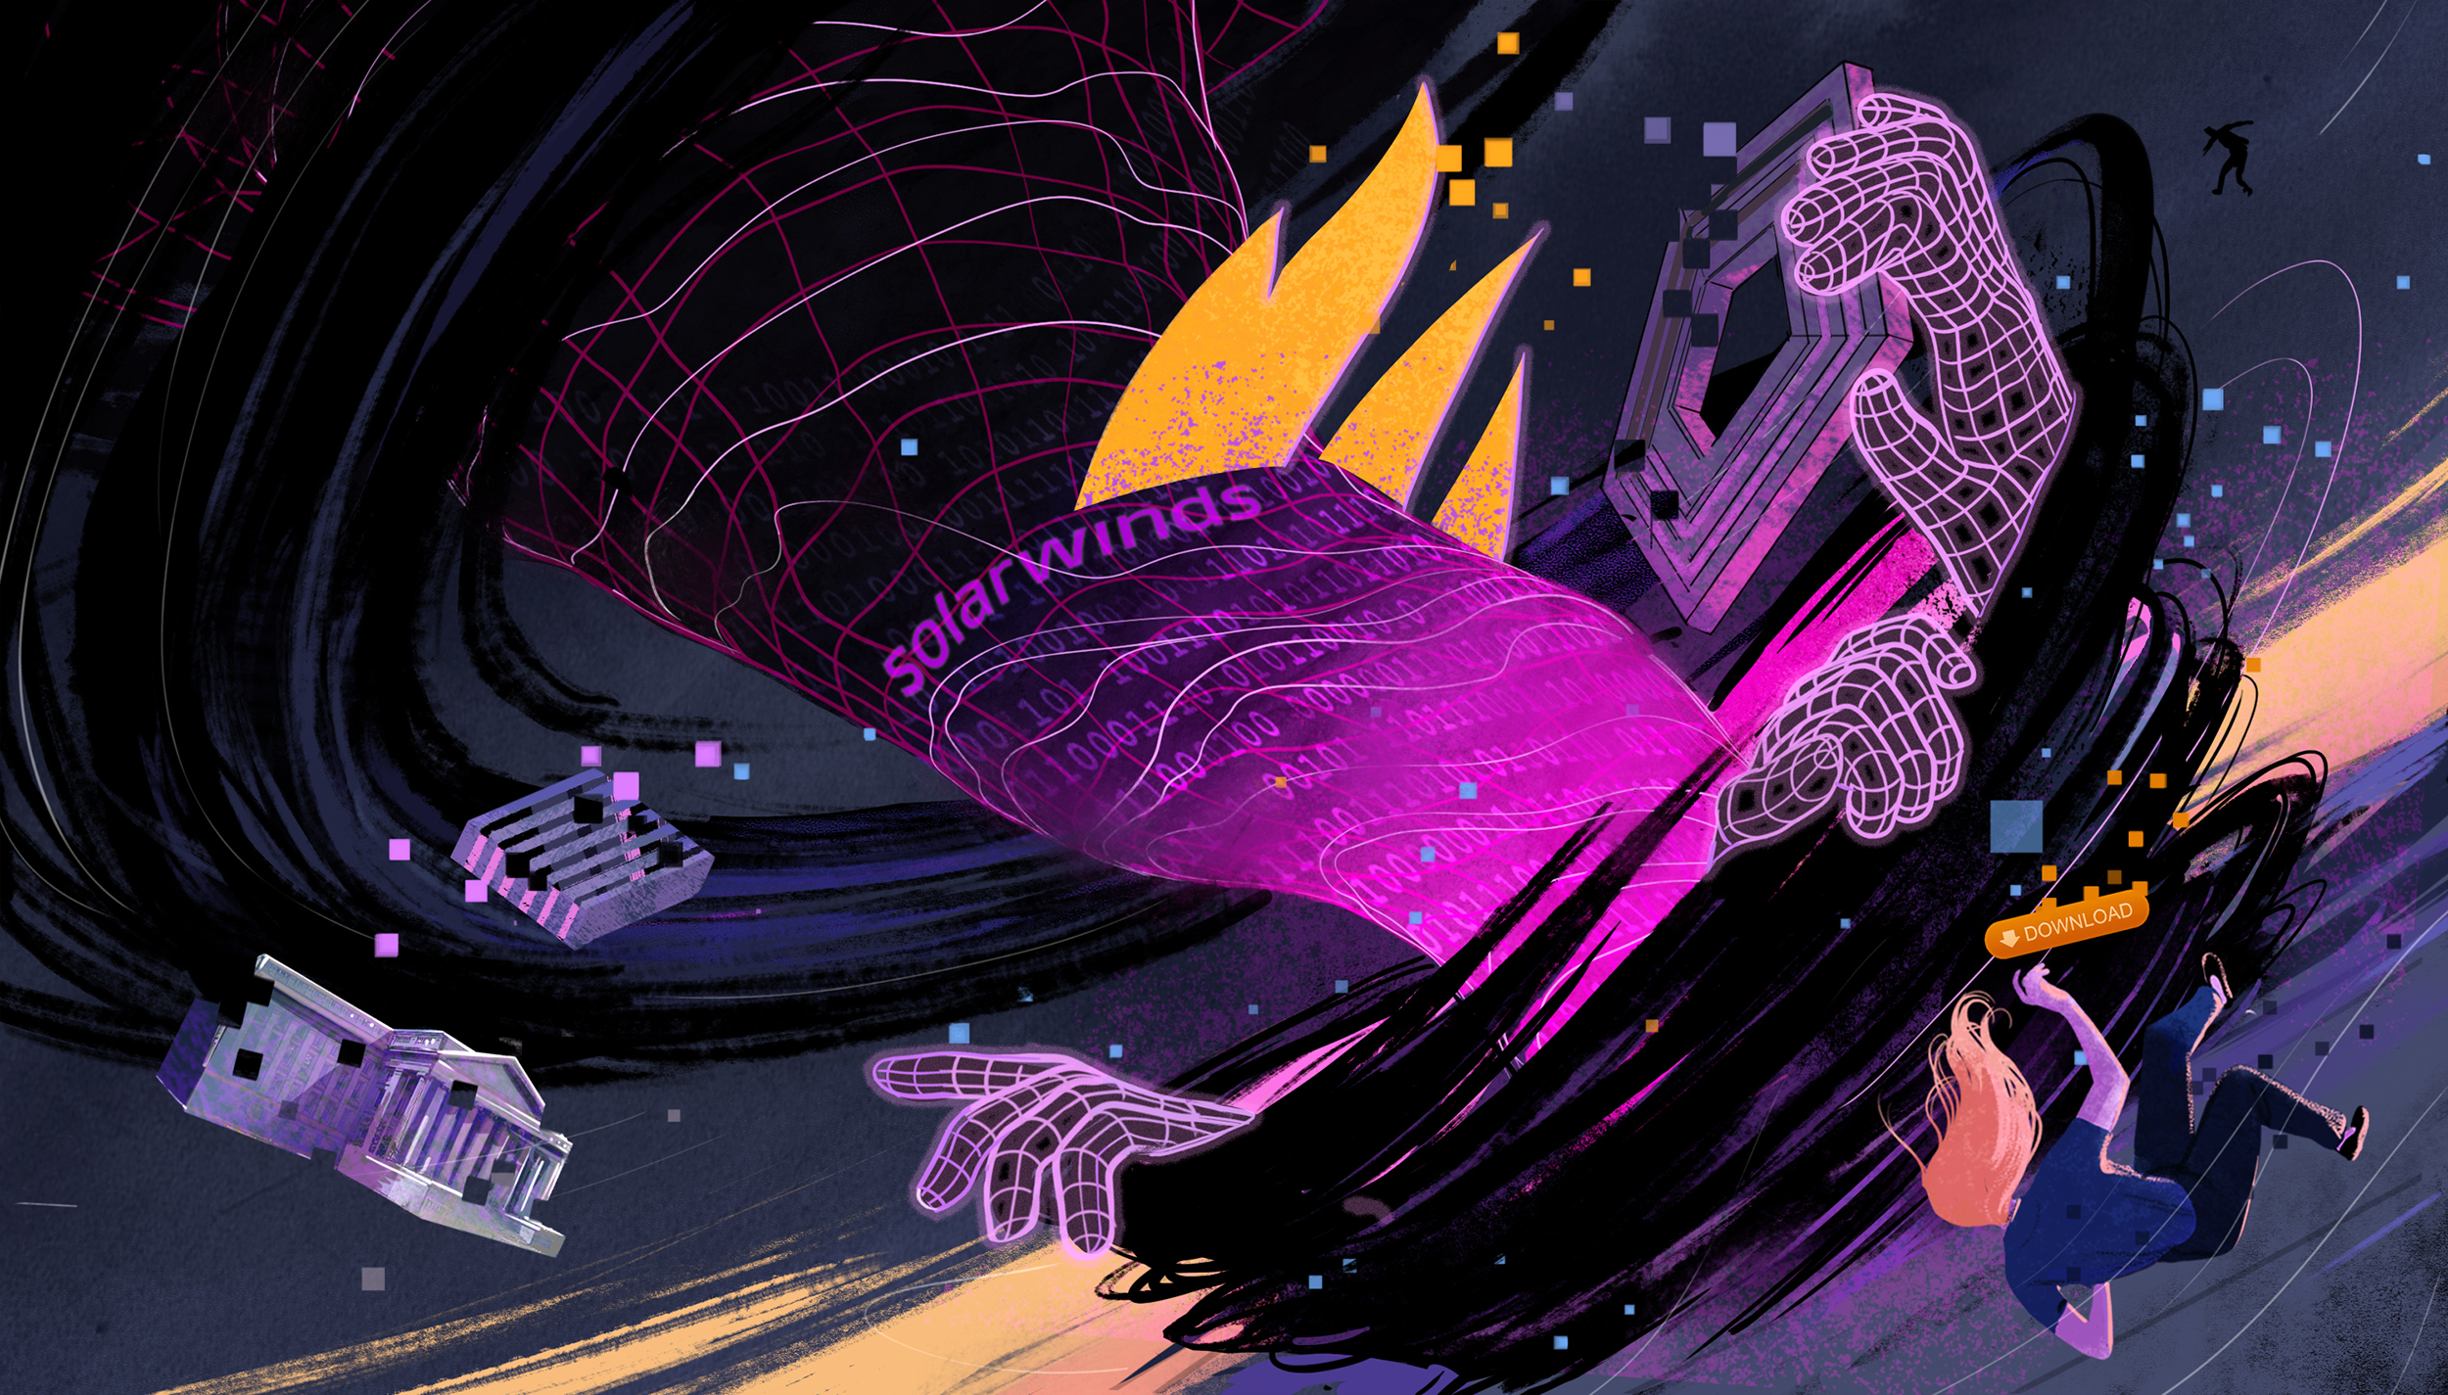
SolarWinds Hack
Company and CISO recently charged as a result of the 2020 supply chain attack
Believed that 18,000 customers downloaded the infected update
Attack spanned the period of years, as early as Jan 2019 – Dec 2020
Supply chain attack on the source code of trusted software
Major lessons learned when it comes to creating secure code builds

Slide 3
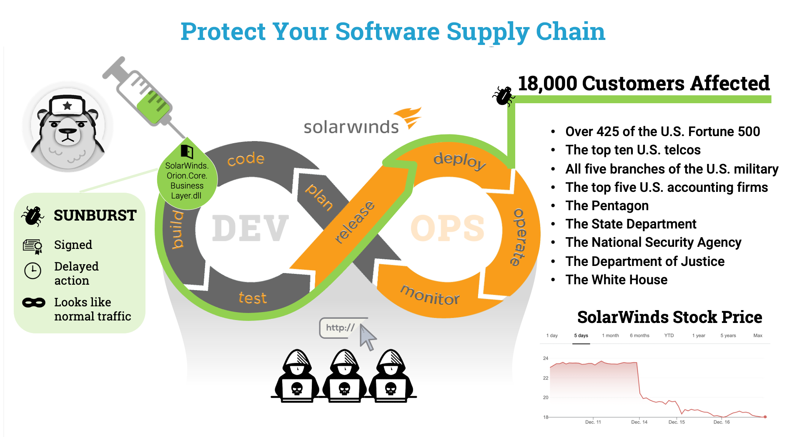
By Eric Byres @ https://blog.adolus.com/three-things-the-solarwinds-supply-chain-attack-can-teach-us

Slide 4
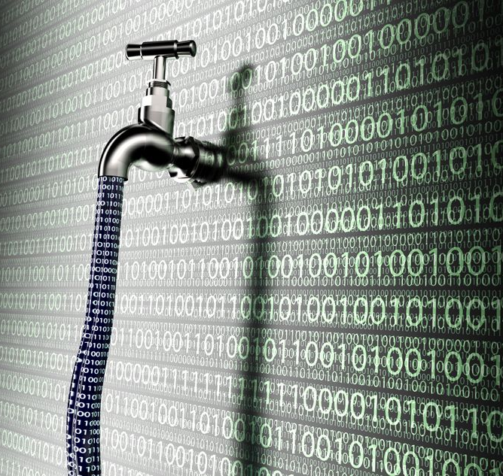
Major ServiceNow Concern
Misconfiguration in widget allowed unauthenticated access to data
Affects around 70% of total instances
Types of data exposed include PII and internal documents
No direct leaks have been attributed to date

Slide 5
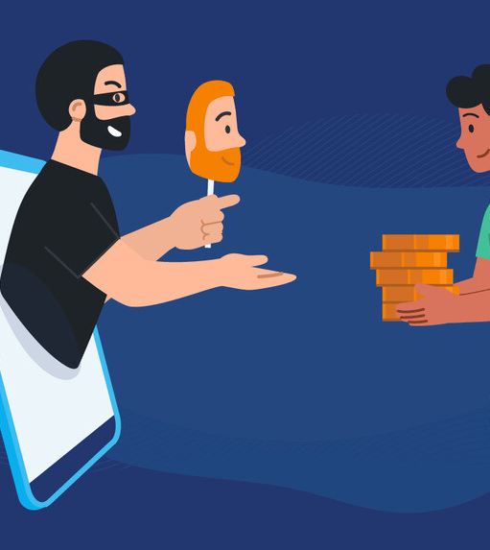
Passwords and Social Engineering
80% of confirmed breaches are related to stolen passwords
Users who don’t use password managers are 3x more likely to experience identity theft
Most common password for 2023 is "123456"
More than 1 in 4 individuals are unsure when they last changed their email password
Watch out for fake job offers on LinkedIn using social engineering tactics to spread malware

Slide 6

Sources
https://www.bleepingcomputer.com/news/security/fake-corsair-job-offers-on-linkedin-push-darkgate-malware/
https://www.darkreading.com/attacks-breaches/sec-charges-against-solarwinds-ciso-send-shockwaves-through-security-ranks
https://thehackernews.com/2023/10/servicenow-data-exposure-wake-up-call.html
https://www.darkreading.com/attacks-breaches/judge-spares-former-uber-ciso-jail-time-over-2016-data-breach-charges
https://www.wired.com/story/the-untold-story-of-solarwinds-the-boldest-supply-chain-hack-ever/
https://cybernews.com/news/boeing-data-leak-lockbit-ransomware/
https://www.bleepingcomputer.com/news/security/tp-link-smart-bulbs-can-let-hackers-steal-your-wifi-password/
https://us.norton.com/blog/privacy/password-statistics

